Slide 1
Validity and Reliability

Slide 2
Modes of Measurement in Psychology
Self-Report,
Peer-Report,
Parent-Report,
Teacher-Report
Participants describe or rate themselves (or others) on some measure
e.g., happiness rating scale
Direct, easy, but subjective and could be biased or inaccurate
Physiological
Measure some aspect of the body or brain
e.g., blood pressure, EEG
Objective, but difficult to obtain, hard to relate to constructs, imprecise
Behavioral:
Measure some aspect of observable behavior
e.g., # smiles
e.g., Reaction time, EAR
Measured by people
Can be difficult to measure reliably
Can be objective, but can be influenced by situational factors
Measured by machine

Slide 3
Key Qualities in a Measure
Reliability: The degree of consistency with which a test measures a variable/construct.
Construct Validity: The extent to which a test measures what is supposed to measure

Slide 4
Reliability
Another way to think about it: The extent to which a measurement captures a true score on a variable
Achieved if the same individuals measured under the same conditions produce nearly identical measurements
If a test measures a variable perfectly (e.g., extraversion), will the same individual get exactly the same score on the test every time?
NO! Always some amount of error during measurement

Slide 5
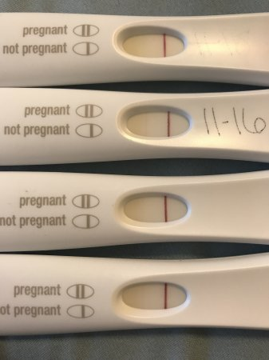
Reliable or Unreliable?

Slide 6
Types of Reliability
When you give someone the same test multiple times, they should get about the same score each time
Test-Retest
If you have two or more observers watching the same behavior, their measurements should agree with each other
Interrater
Internal Consistency
Within a test, people should respond similarly to questions that measure the same construct

Slide 7
Ways to Increase Reliability
1.
Have good operational definitions
How do you operationalize “depression”?
Feelings of despair?
Sleeplessness? Fatigue?
Lack of motivation? Anger?
Include multiple items within each measure
2.
Include multiple measures for each variable/construct
The Beck Depression Inventory
Accelerometers (activity levels)
Self-report of symptoms
3.

Slide 8
Sensitivity & Range Effects
Measurement tools must be sensitive enough to record real changes or differences in performance
Ceiling Effect: clustering of scores at high end of scale
Floor Effect: clustering of scores at low end of scale

Slide 9
Key Qualities in a Measure
Reliability: The degree of consistency with which a test measures a variable/construct.
Construct Validity: The extent to which a test measures what is supposed to measure

Slide 10
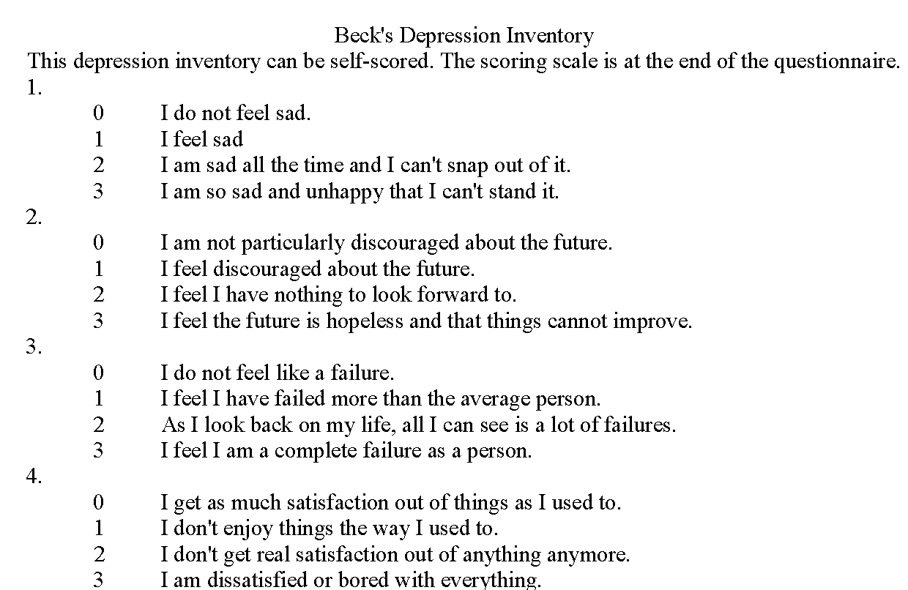
Construct Validity
Face Validity
The content of the measure appears to reflect the construct being measured

Slide 11
Construct Validity
Face Validity
The content of the measure appears to reflect the construct being measured
Content
Validity
The content of the measure actually reflects the construct being measured

Slide 12
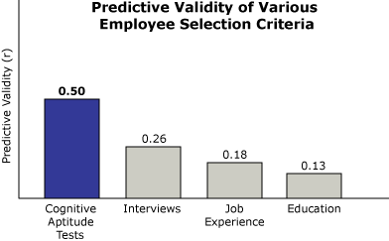
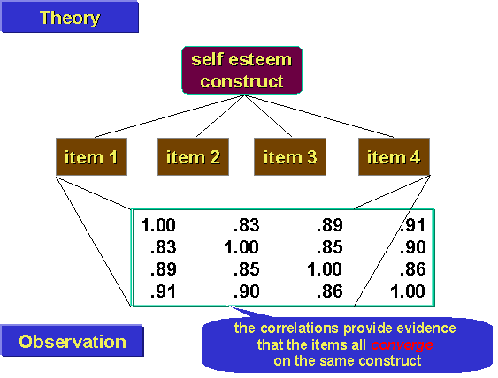
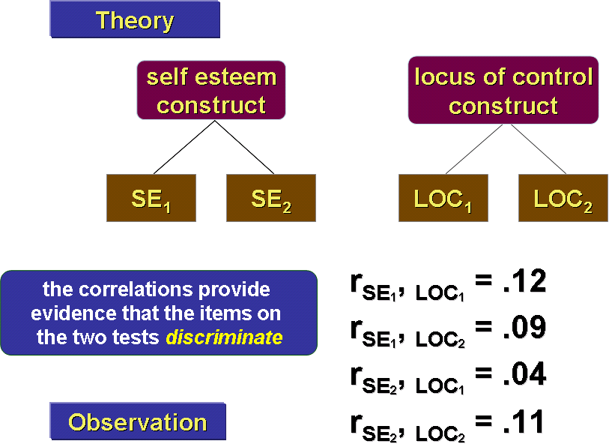
Content Validity
Predictive: The measure of a construct accurately predicts a future hypothesized behavior (behavior can also be measured at same time - concurrent)
Convergent: The measure of a construct is related to other measures of the same construct
Discriminant: The measure of a construct is NOT related to other measures that are theoretically different

Slide 13
Relationship Between Reliability & Validity
Goal = high reliability and validity
Can a measure can be highly reliable but not valid?
Can a measure be valid but not reliable?

